Slide 1
Supply Chain Resilience in the COVID Age

Slide 2
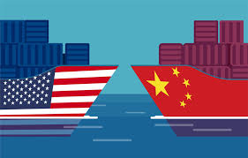



What a Journey!
Set-up to 2020
What changed in 2020?
What changes in 2021?
Long term supply chain implications

Slide 3
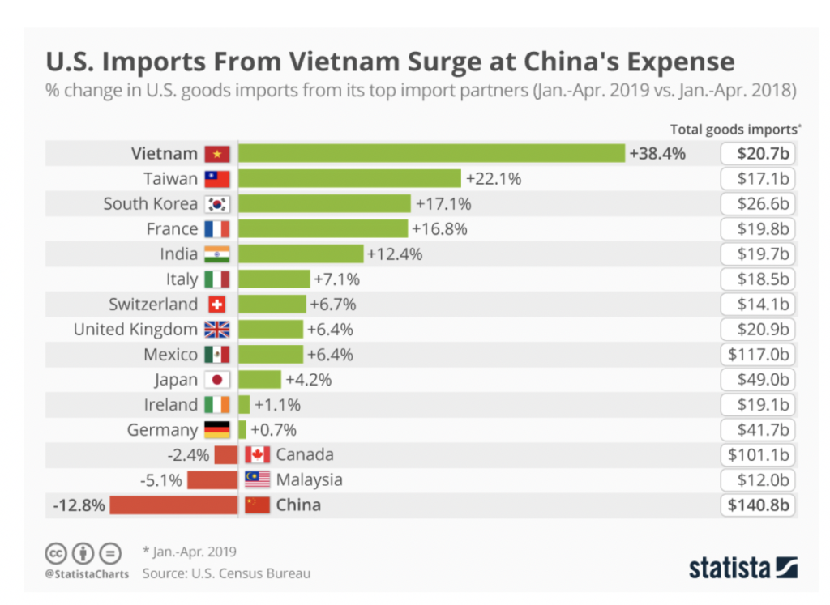
2 Years Ago…this was shifting

Slide 4

And then 2020 happened…
  Demand Uncertainty
  Availability
  Logistics
  Tariff holdover
Realization: We don’t have the chops to manufacture enough in the USA!
Credit: Britt Spencer

Slide 5

2021 - What is in store for us?
Continued Logistics Challenges
  Passenger flights down
  Airlines shifting to more freight-only flights
Stops and Starts
  Scramble for space and supply
  Unexpected shortages (IC’s, packaging material, PPE)
Tension with China
  Biden administration not backing down
Shortages
  Lower level material
  Worker availability
  Government rules
Surprises
  Unknown unknowns….

Slide 6

Long Term Implications?
  Increased automation in manufacturing and logistics
  More investment in industrial segment in the USA
  Higher value placed on shorter supply chains
  More repair versus return
  Diversification for increased resilience
  Higher value placed on supply chain management

Slide 7

Develop a Strategy and Execute
Punitive Tariff Reduction:
  Shift to non-China country for Substantial Transformation
  Launch next gen product elsewhere
  De Minimus shipping – small batch shipments
Invest in resilience
  Use total landed cost when making supplier decisions
  Know where your supply is located and reduce risk
Purposeful Supply Chain Management & Design
  Double down on Supply and Operations Planning
  Know where your supply is located and reduce risk
    2nd source
    Inventory positions
    Diversify

Slide 8
marcy@ontap.consulting
925-437-4125

