Slide 1

Krannert Spring Conference
Economic Impact of the Pandemic and Legislative Progress

Slide 2
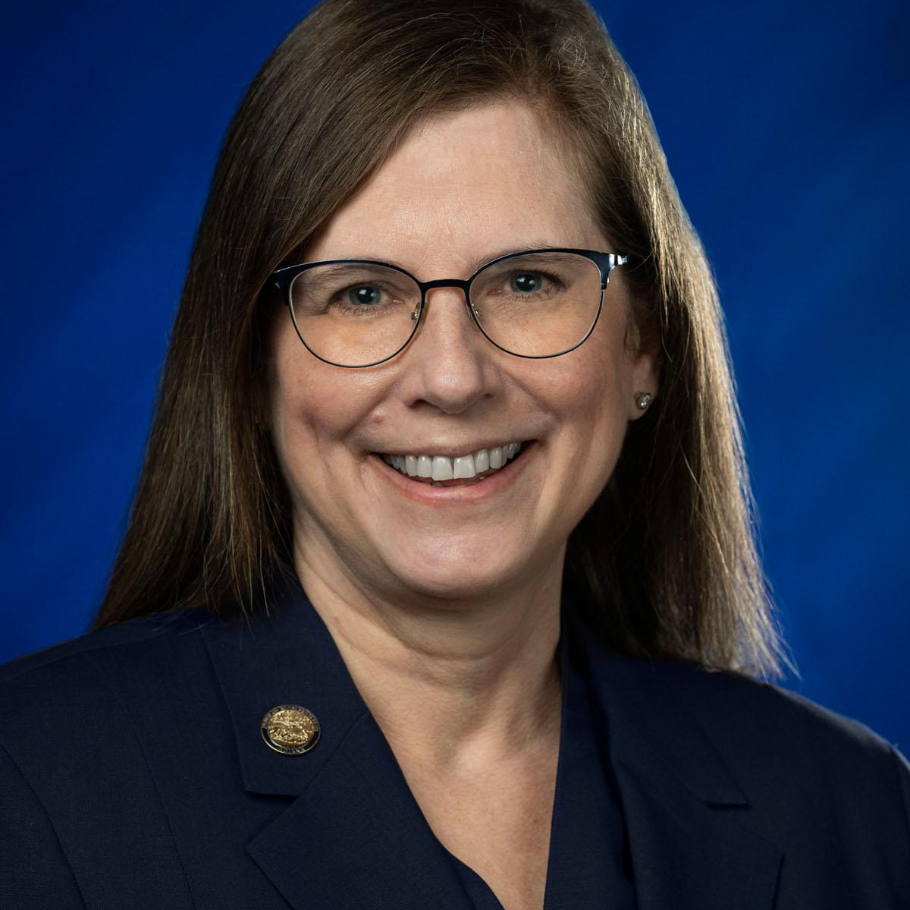
Chris Campbell
Staff:
State Representative — District 26
Tippecanoe County
h26@iga.in.gov
Jalen Jones
Legislative Assistant
317-234-3101
jalen.jones@iga.in.gov
Tyleeah Stanley
Legislative Intern
317-234-9039
tyleeah.stanley@iga.in.gov

Slide 3
Grant Programs
HB 1004 - Small Business Restart Grant Program
o It requires the State Department of Health to consult with the Office of Secretary of Family and Social Services (FSSA), to study and prepare a plan to improve the health and behavioral health of Indiana residents.[19]
o It requires the State Department of Health to administer the grant program and give preference in awarding the grants based on specified criteria.[20]
HB 1007 - State Health Improvement and Grant Program
o The bill creates a grant program to help businesses with less than $10M in annual gross revenue in the:

Slide 4
Education
HB 1003 - Tuition Support
o It increases the amount of funding a school receives for virtual students.
o Guarantees that schools receive the same amount of money for virtual students as they do for in person students.
HB 1449 - Broadband Development
o Invests an additional $250m into rural broadband infrastructure to provide high-speed, reliable internet to Hoosiers.
o Prioritizes schools and rural health clinics that do not have access to 1GB per second downstream internet.
o Hoosiers without access to broadband at their homes will be able to request broadband through an online portal. Broadband providers will compete to provide service to those who want broadband.

Slide 5
Agriculture
HB 1103 — Home Based Vendors
O This bill allows a home-based vendor's food products to be:
§ (A) sold in person or by telephone or the Internet;
§ (B) delivered by the vendor or a third party carrier to the consumer.[30]
o Requires the State Department of Health, State Board of Animal Health, and State Department of Agriculture to consult with experts to develop recommendations about potential risks that may arise.[31]
HB 1283 — Urban agricultural Zones
o Allows qualifying farmers to apply for an area used for an urban agricultural zone.
o The designating body must hold a public hearing for public commentary before assigning designated areas to the farmer.

Slide 6
Local Economic Development
HB 1072 - Personal Delivery Devices
O The bill sets out rules and regulations for the use of personal delivery devices.
O Allows for local governments to restrict the use of personal delivery devices.
HB 1138 - Driver Cards
o The bill essentially would have allowed a person to obtain a driver’s license or permit if they passed their driving test regardless of the US lawful status.
o This bill would have saved Hoosiers an average of $25 on their premiums [each] year.
HB 1520 - Electric utility reliability adequacy metrics
O This bill encourages greater energy self-sufficiency in Indiana by requiring utilities to produce the majority of their energy in Indiana.

Slide 7
Etc.
HB 1001 - Meat & Poultry Appropriation - Amendment #12
o Increases the meat and poultry line item within the state board of animal health budget by $362,800 per fiscal year.
o New appropriation will be 1,965,106 annually.
o This will add 10 meat inspectors for the meat industry.
HB 1418 - Economic Development Issues
o It establishes provisions that require greater transparency in the state and local government actions related to incentives received by the IEDC and the IDDC.

Slide 8
Small Business Assistance Programs
IEDC - Indiana PPE Directory
SBA Disaster Loans for Small Businesses
Paycheck Protection Program
Small Business Debt Relief
Indiana Small Business Development Center
Hometown Business Preservation Initiative
Programs set up in Indiana to assist small businesses using CARES ACT funding. Most of which have been signed through executive orders by the Governor.

Slide 9
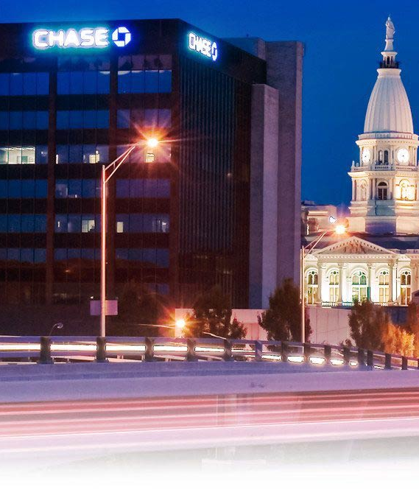
Thanks!
Any questions?
h26@iga.in.gov

