Slide 1


Speaker: Monique Apter, Roy Vasher
Monique Apter
Vice President of Sales, HDS Global
Presented by: Roy Vasher, WHIN Education Consultant, Co-Author “Toyota Supply Chain Management” book

Slide 2

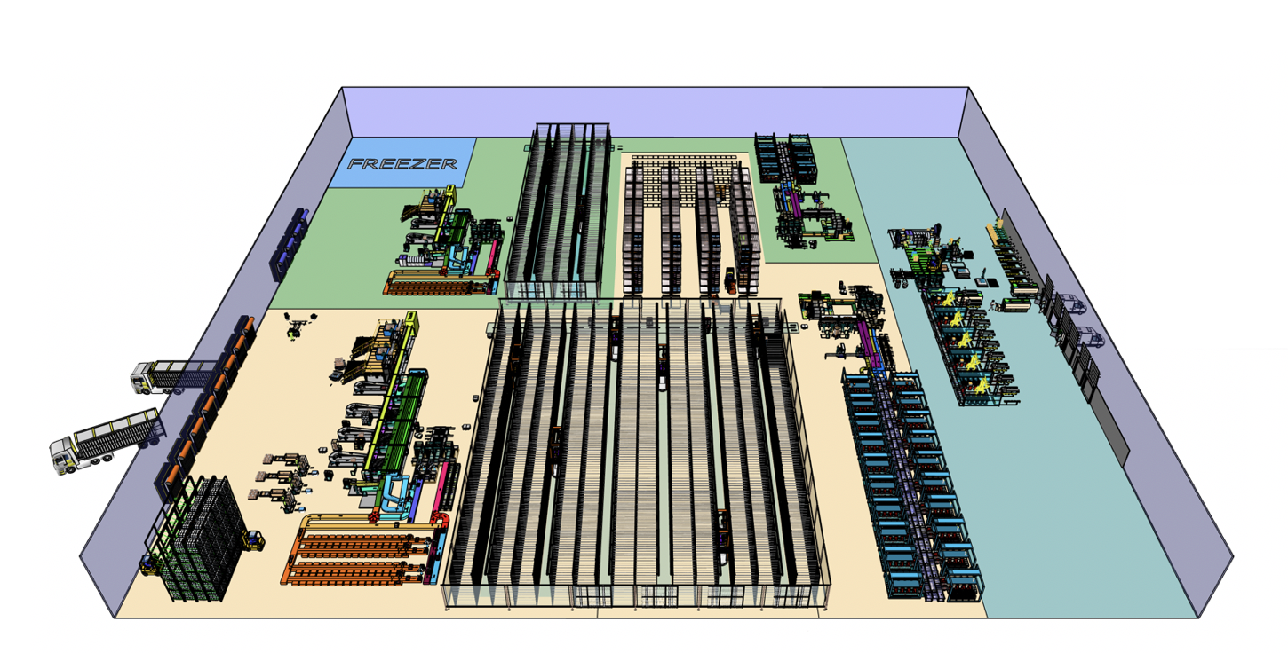
HDS

Slide 3
Home Delivery Services (HDS)
Our company will deliver high quality groceries and general goods at a fair price.
To do that, we have developed RoboFSTM, our proprietary robotic fulfillment system, to completely reimagine the online shopping and delivery experience.

Slide 4
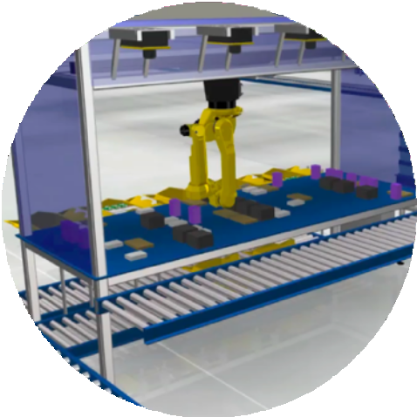
RoboFSTM Available for Others to Leverage
We created RoboFSTM for HDS, but will also provide to select partners
Provide full-stack hardware and software to Global 200 companies in non competing industries
Increased throughput at half the cost
Agreements in place with Ingram Micro and Toyota
B2C
HDS
B2B
Non-Competing
Verticals

Slide 5
Our Design Process Began with a few “Non-Starters”
Thoughtful, purpose-built technology elevates HDS above the competition
Monolithic Solutions
Building Point Solutions
Conveyors Between Modules
Module Proliferation
Customization
Rigid Containers
Legacy Software
PLC-Based Controls
5

Slide 6


RoboFSTM: Productized Design for Scale
ONE-OFF
vs.
PRODUCT
DESIGN PRINCIPLES
Integrated hardware/software development (Apple not Android)
Plug-and-play cells, configurable modules
Data-driven, with AI/ML at its foundation
Flexibility through configuration, not customization
COMPELLING BENEFITS
Quick set up and deploy time
Predictive demand, AI-based simulation, and rapid execution
Scales efficiently
Synthesizes diverse requirements to enable general purpose solution
6

Slide 7
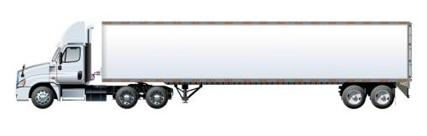
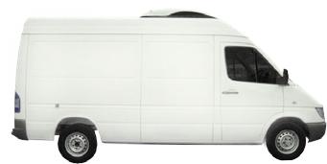
Introducing RoboFSTM
Creating end-to-end-to-home fulfillment center capabilities
$200M revenue from a 150K sq. ft. facility
50% lower cost than current fulfillment systems
Modular, scalable, and configurable
HDS*
HDS*
RECEIVE
STORE
PACK
DELIVER
MOBILE ROBOTS
ROBOFS MANAGEMENT SOFTWARE

Slide 8
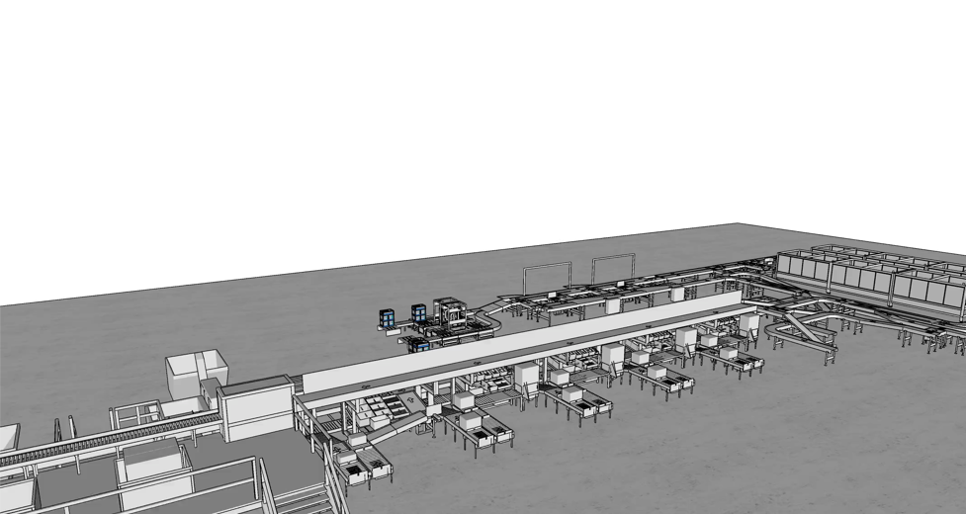
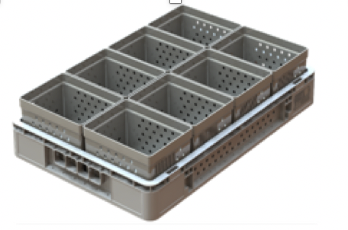
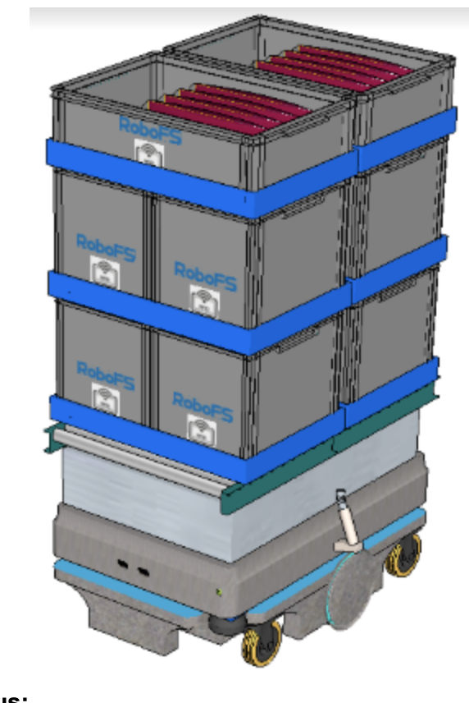
Receive
Goods organized for high density storage and automation handling
TRAYS
Lego-style, single footprint, accommodates variable product sizes
MOBILE ROBOTS
High-throughput with double stacks of trays prepared for any destination
STATUS
» Patent filed: Stack handler
» Under construction, Q4 delivery

Slide 9
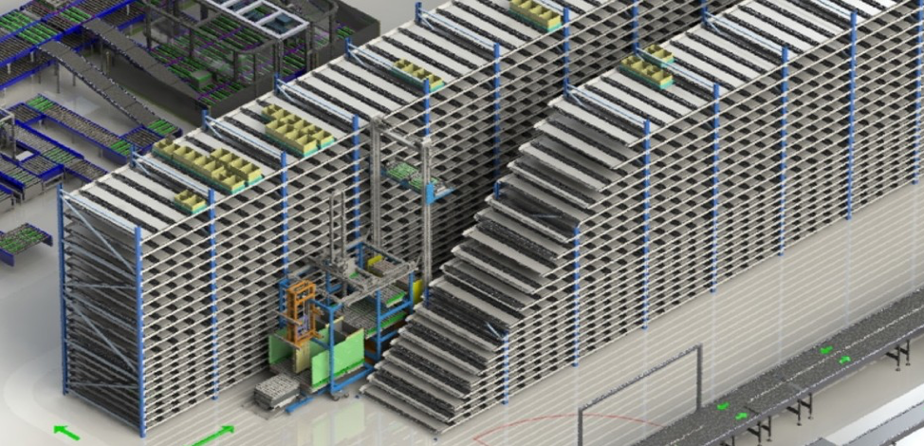
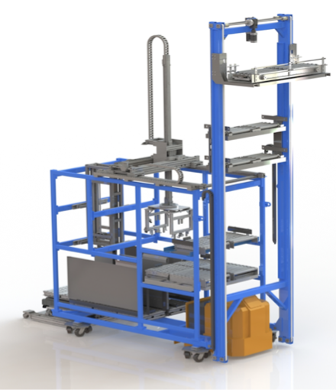
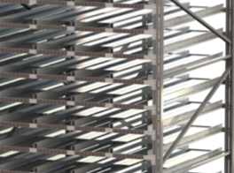
Store
Fully automated, high density storage
ROBOFRAME
First autonomous parallel processing storage and retrieval system
RACKS
4-deep, no precision steel, no electronics
STATUS
» Patents granted: Robotic frame and power transfer device
» Design finalized, Q1 delivery

Slide 10
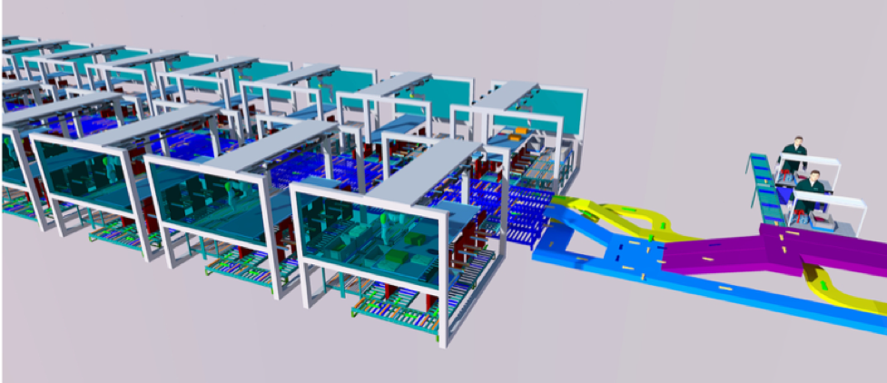
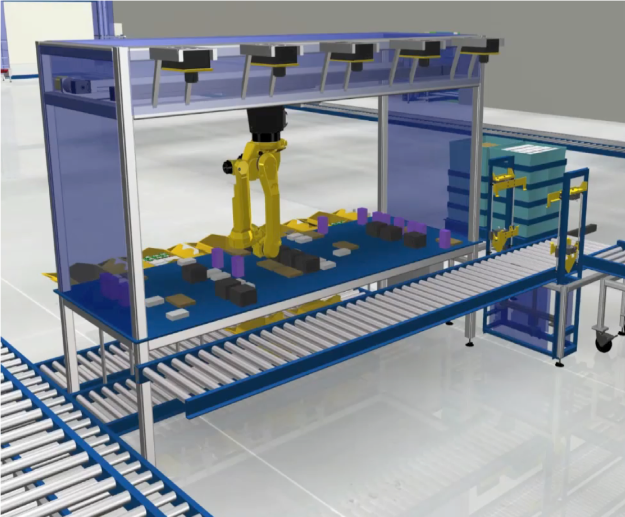
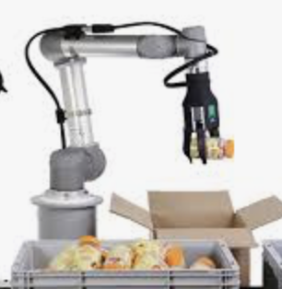
Pack
More than 95% of items picked automatically at 600 pph
PICK STATIONS
Multiple pick stations/multiple grippers greatly simplify automated picking
AUTOMATED PICK
Fully functional software using AI/ML
STATUS
» Patent being filed: Random access automated pick
» Design finalized, Q1 delivery

Slide 11
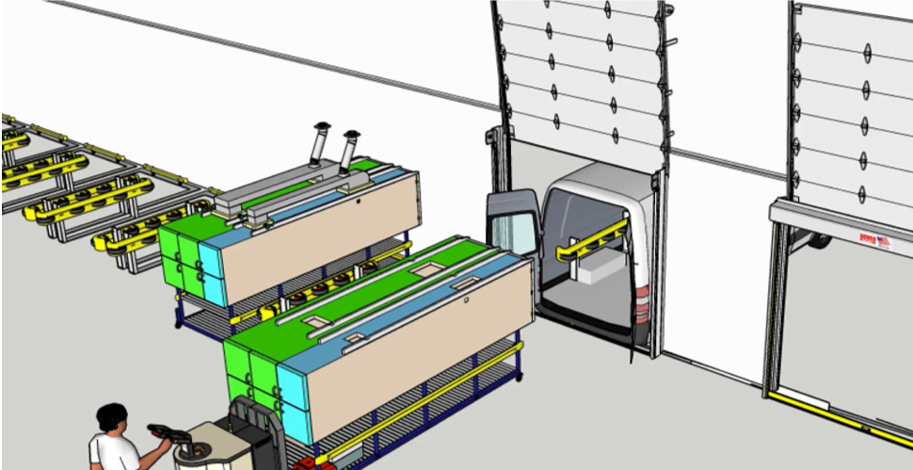
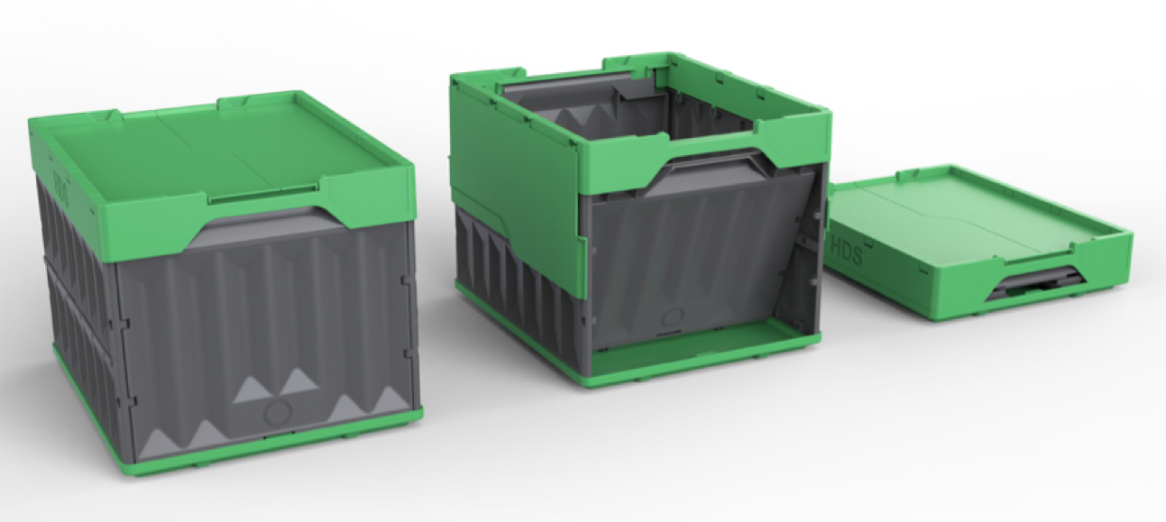
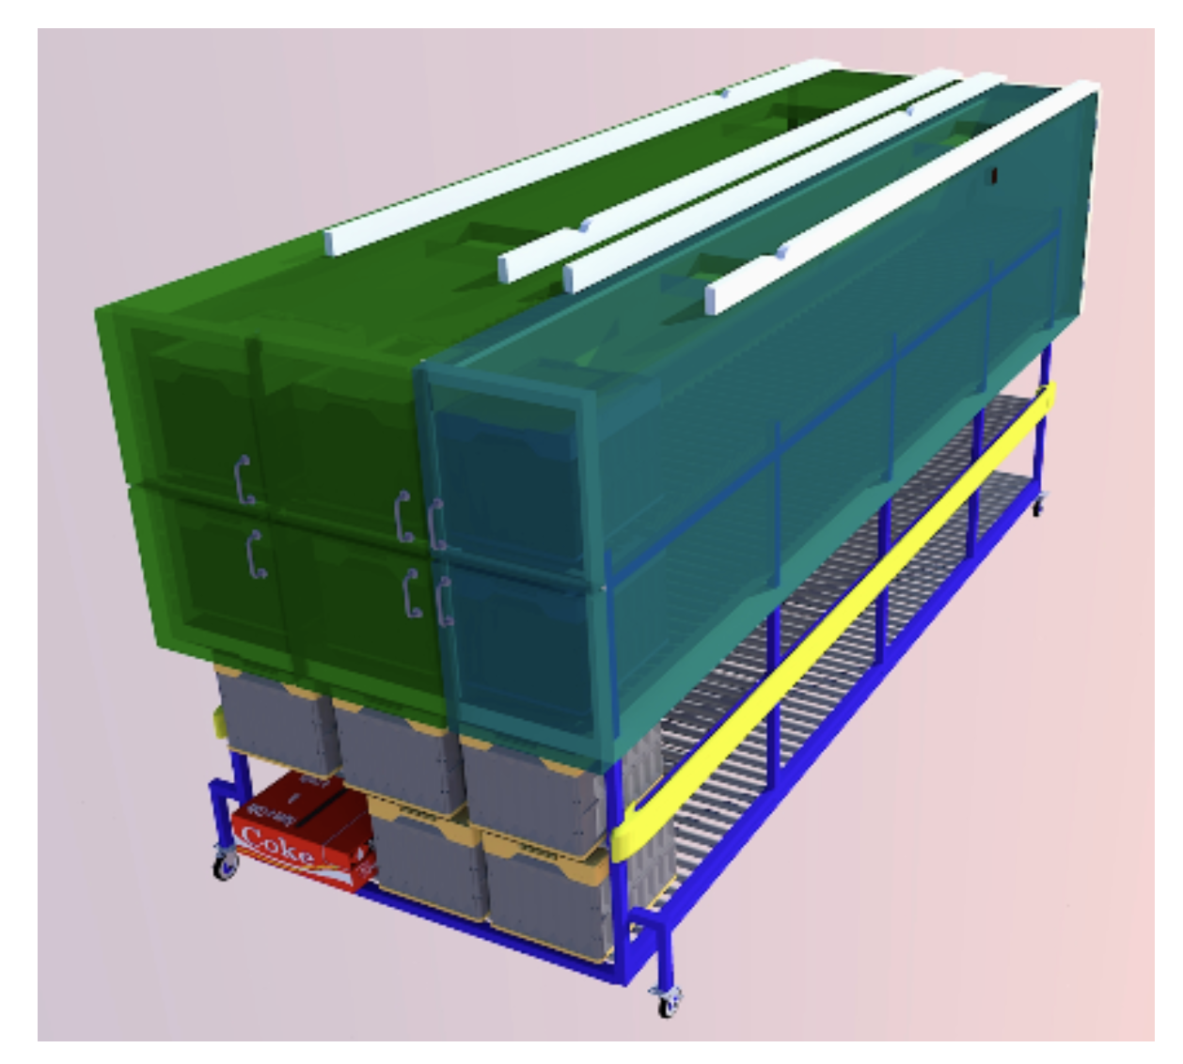
Deliver
Automated tote loading, 5 minute van turnaround, easier courier work
TOTES
Reusable tote, industrial yet practical in the home
VAN CARTRIDGE
Tri-temperature chill chain control to the home (no insulated containers, no dry ice)
STATUS
» Patent filed: Vehicle insert and method of vehicle loading/unloading
» Design in process

Slide 12
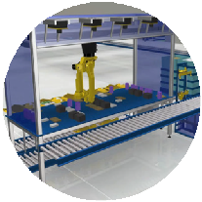
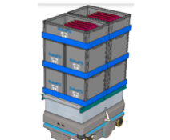
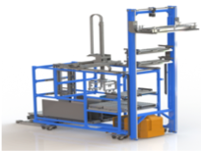
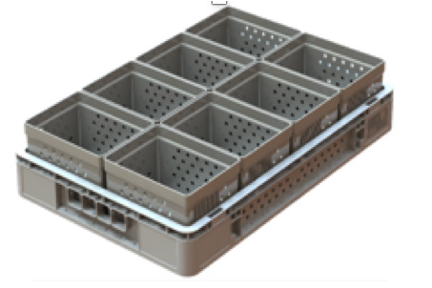
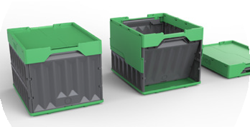
HDS Key Innovations
Automated Pick
Fully functional software using AI/ML
Pick Stations
Multiple pick stations/multiple grippers greatly simplify automated picking
Mobile Robots
High-throughput with double stacks of trays prepared for any destination
Van Cartridge
Tri-temperature chill chain control to the home (no insulated containers or dry ice)
Trays
Lego-style, single footprint, accommodates variable product sizes
RoboFrame
First autonomous parallel processing storage and retrieval system
Racks
4-deep, no precision steel, no electronics
Totes
Reusable tote, industrial yet practical in the home

Slide 13
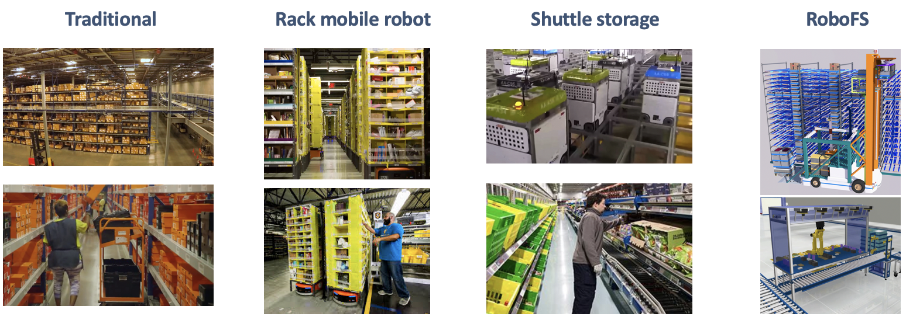
Nothing comparable on the market
Key elements | Miles of walking | Density challenges | Monolithic storage | Robotic storage & transport
Pick and pack | Manual | Manual | Manual | 95% Automated
Cost per item | >$2 | $>1.50 | $>1.00 | <$.60

Slide 14
Industry Leaders Have Validated RoboFSTM via Successful Case Studies
WHOLESALER
Designed 250k sq. ft. greenfield floorplan
MASS MERCHANT
Retrofitted existing L-shaped facility to free space
CLUB STORE
Improved dark store capacity over current system
66%
Headcount Reduction
50%
Cost/Unit Reduction
33%
Space Reduction
1.9x
Throughput Increase
1.5x
SKU
Expansion

Slide 15
Thank you!

