Slide 1
TP^3 – Product Opportunities
Ananth V Iyer
Susan Bulkeley Butler Chair in Operations Management
Jamuar Shikar, Gautam Venugopal (GA)
Thakkar Dutt, Steve Dunlop (DCMME center staff)
Krannert School of Management
Purdue University
West Lafayette, IN 47907
aiyer@purdue.edu

Slide 2
The Question
As we recover from the pandemic, what product opportunities should our company pursue given
Our Equipment
Our people and their skills
Our certifications
Our capacity…..

Slide 3
Agenda
Supply Chain Tool
Understanding company similarity – Industries served, Equipment possessed
Dendrogram to develop clusters
Insights from Industry clusters
Insights from Equipment clusters
Collaboration Ideas
Next steps

Slide 4
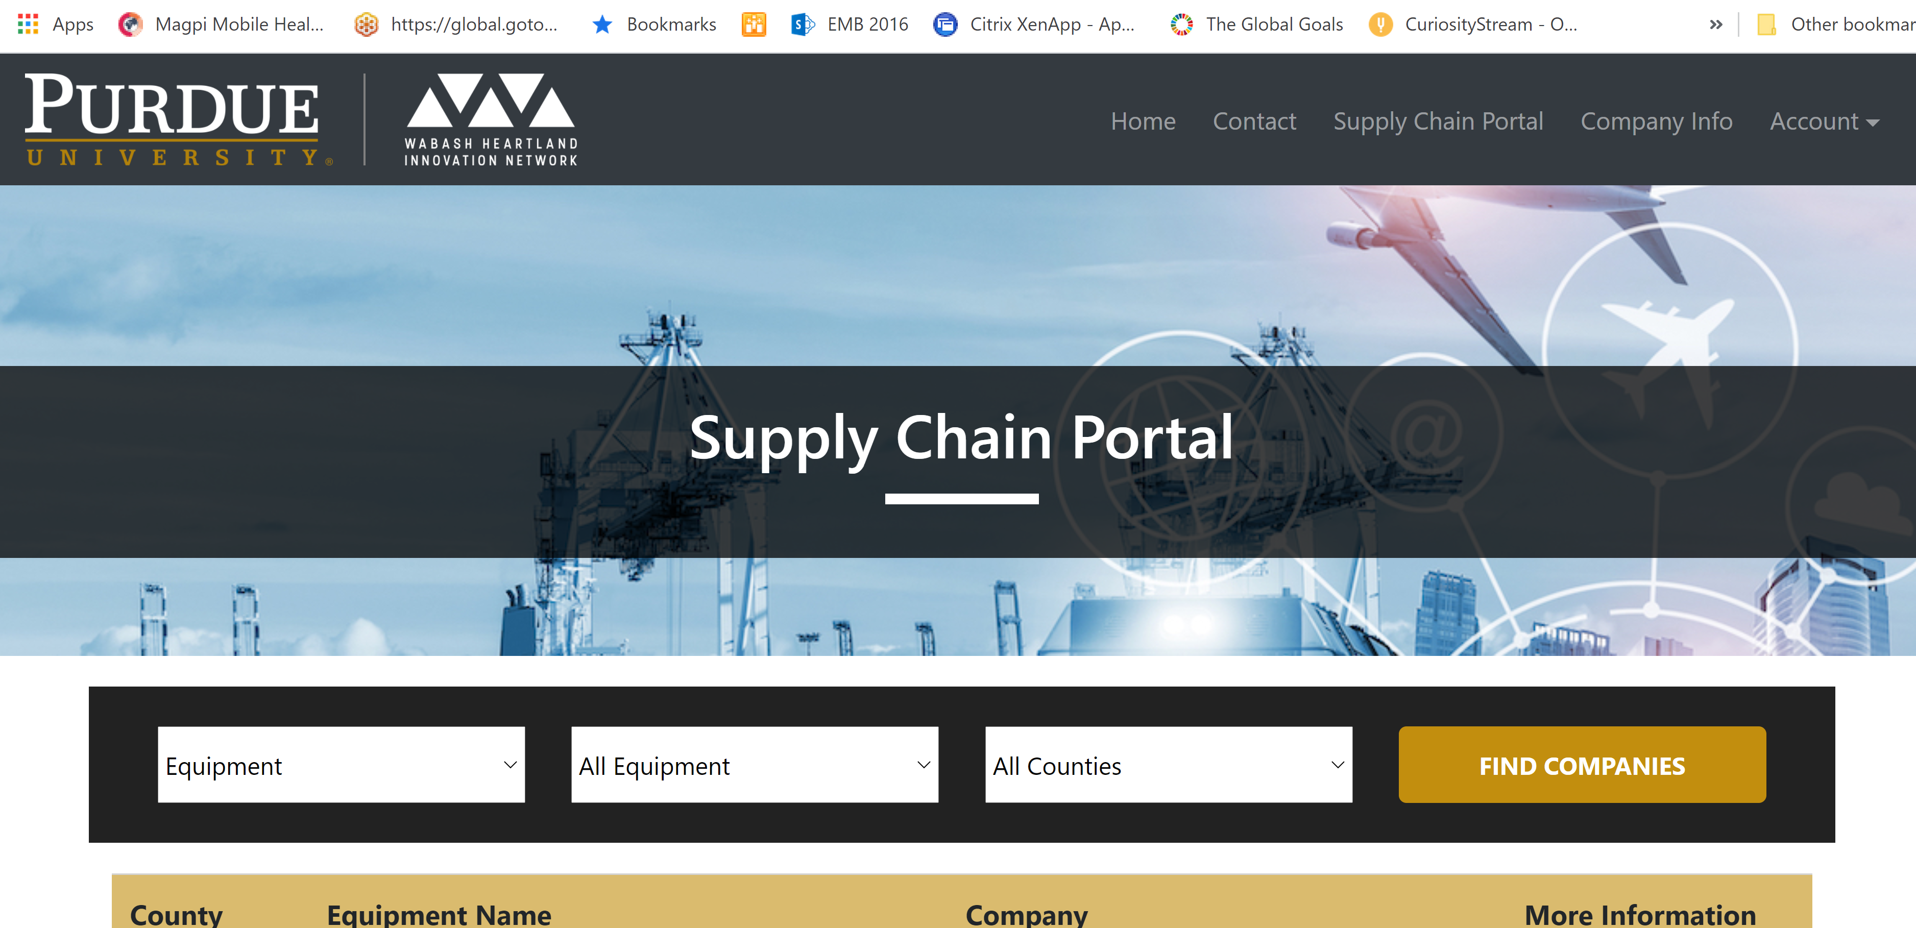

Slide 5
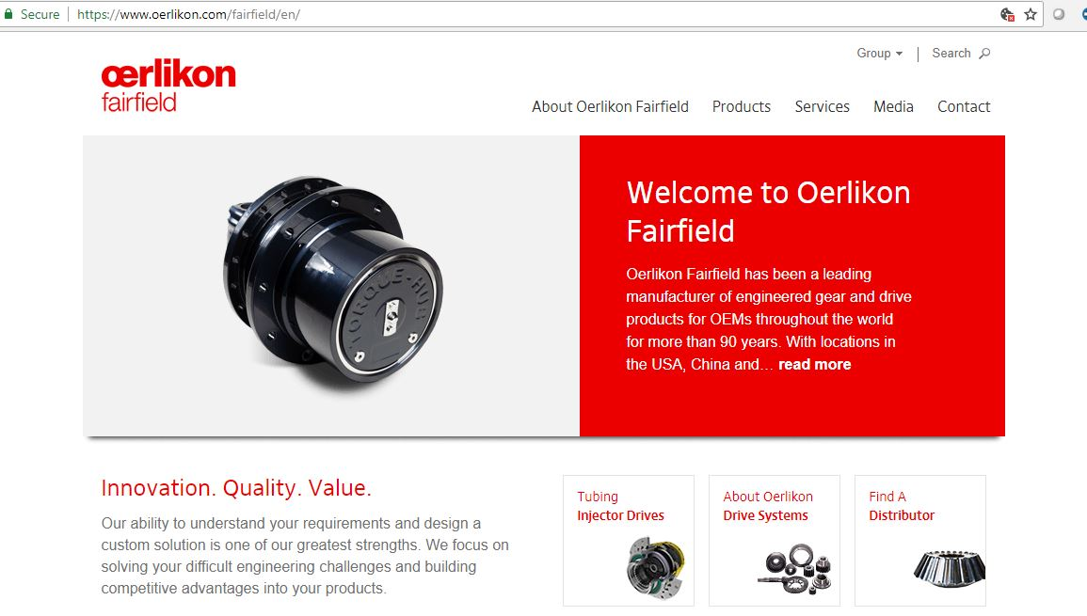
What is the problem ?
Example: Oerlikon Fairfield
URL https://www.oerlikon.com/fairfield/eng
Large numbers of weblinks (441 weblinks)
Many pages of raw data (602 pages)
Several individual searches to get an answer
Context dependent interpretation
Long run time (over 3 hours for one company)

Slide 6
Step By Step Process
Web Crawling
Web Scraping
Query the data

Slide 7
What have we learned ?
Companies are located at all levels of the supply chain
They are spread across the 10 counties
Most of the companies have a web presence
They have a diverse set of equipment
Many of the companies provide certifications
Product descriptions are nonstandard and need sematic search to be effective

Slide 8
Next Steps
Developed 151 attribute values for the 278 companies in the WHIN region
Cover industries, products, equipment, certifications
Create clusters of companies
Explore subsets of companies with required set of capabilities for new industry
Find ways to assist LEDOs, procurement managers and companies to work to explore opportunities
Next up – clustering

Slide 9
Attributes
 | A | B | C | E | G | H | I | J | K | L | M | N | O
1 |  | x |  | x |  |  |  |  |  | x
2 |  |  |  |  |  |  | x
3 |  |  |  |  |  |  | x
4 | x | x | x | x |  |  | x |  |  | x | x | x | x
5 | x |  | x |  |  |  | x |  |  | x |  |  | x
6 | x | x |  | x |  |  | x
7 | x | x | x | x |  | x | x |  |  | x | x | x | x
8 |  |  |  |  | x |  | x
9 |  |  | x |  |  |  |  |  |  |  |  |  | x
10 |  | x |  |  |  |  |  |  |  | x | x |  | x
11 |  |  |  |  |  |  |  |  |  | x | x |  | x
12 |  |  |  |  |  |  | x |  |  | x |  |  | x
13 |  | x |  | x |  |  | x |  |  | x
14 |  |  |  |  |  |  |  |  |  |  |  | x
15 | x |  |  | x |  |  | x |  |  | x |  |  | x
 | A | B | C | E | G | H | I | J | K | L | M | N | O
4 | x |  | x | x |  |  | x |  |  | x | x |  | x
5 |  | x | x |  | x | x |  | x | x |  | x | x | x
6 |  | x | x | x | x | x |  | x | x |  | x
7 | x |  | x | x |  |  | x |  |  | x | x
Companies
Example set of firms with attributes

Slide 10
Similarity between companies
Similarity Index = Attributes in Common/Attributes Union
 | A | B | C | E | G | H | I | J | K | L | M | N | O
4 | x |  | x | x |  |  | x |  |  | x | x |  | x
5 |  | x | x |  | x | x |  | x | x |  | x | x | x
6 |  | x | x | x | x | x |  | x | x |  | x
7 | x |  | x | x |  |  | x |  |  | x | x
 | 4 | 5 | 6 | 7
4 | 1.00 | 0.23 | 0.15 | 0.86
5 | 0.23 | 1.00 | 0.70 | 0.15
6 | 0.15 | 0.70 | 1.00 | 0.27
7 | 0.86 | 0.15 | 0.27 | 1.00
Sim(4,5) = 3/(7+9-3) = 3/13= 23%
Sim(4,7) = 6/(7+6-6) = 6/7 = 86%
Similarity Matrix

Slide 11
 | A | C | E | I | L | M | O | B | G | H | J | K | N
4 | x | x | x | x | x | x | x
7 | x | x | x | x | x | x
5 |  | x |  |  |  | x | x | x | x | x | x | x | x
6 |  | x | x |  |  | x |  | x | x | x | x | x
0.27
 | 4 | 5 | 6 | 7
4 | 1.00 | 0.23 | 0.15 | 0.86
5 | 0.23 | 1.00 | 0.70 | 0.15
6 | 0.15 | 0.70 | 1.00 | 0.27
7 | 0.86 | 0.15 | 0.27 | 1.00
0.7
0.86
7
4
5
6
Cluster 1
Cluster 2

Slide 12
Cluster companies based on Industries served
Automotive 11
Construction
6
Food and Beverage
9
Manufacturing
All three sectors
53
Both sectors
5
Residential+Hospitality
18
Both sectors
4
Retail
Industrial
10

Slide 13
How should I use this information?
Develop within cluster links to expand technology capability
Collaborate within a cluster across products offered
Expand from one cluster to adjacent industry
Collaborate with companies in an independent cluster
Compete within a cluster
How can we assist ?

Slide 14
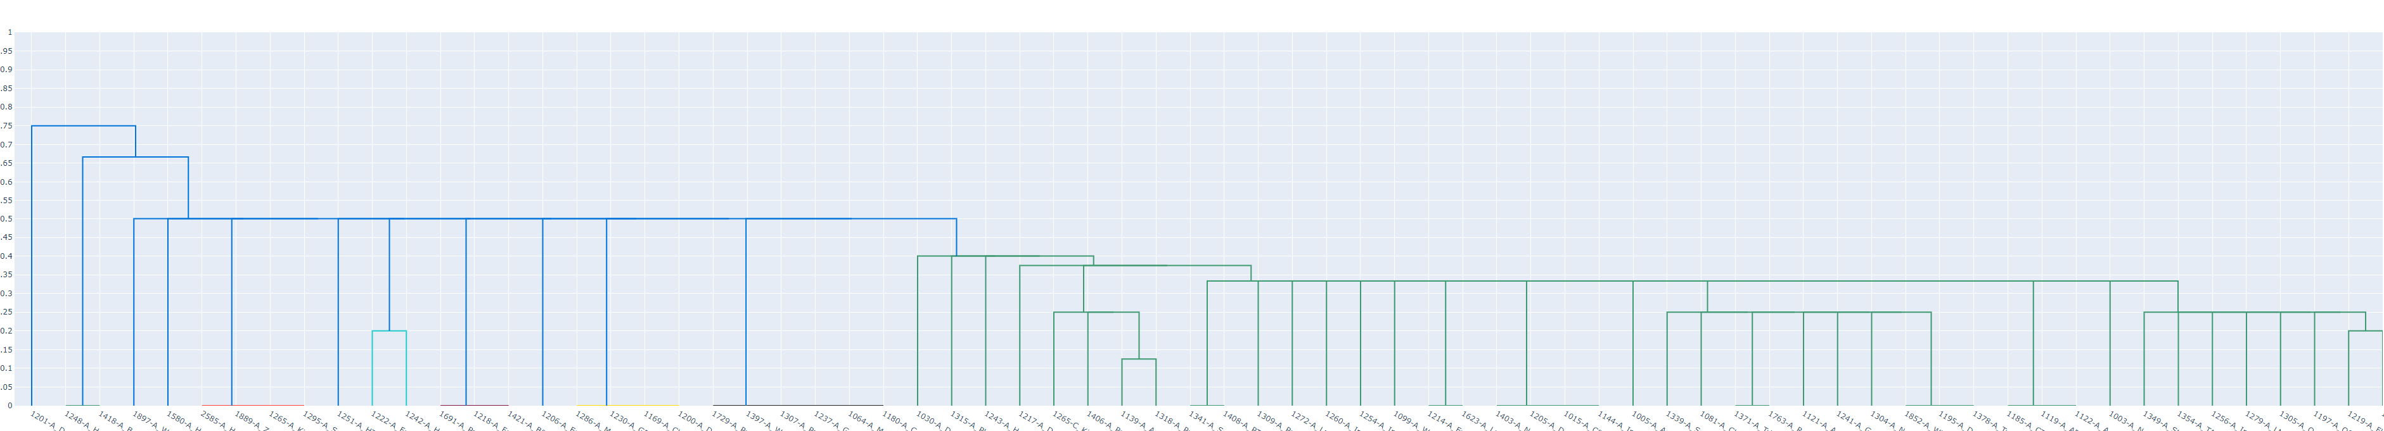
Cluster based on equipment

Slide 15
How do you use equipment clusters ?
Share technology choices, knowledge acquisition
Share training costs for improving skills
Share maintenance information to improve performance
Share capacity with others in a different industry
Collaborate to go after more complex contracts or products
How can we assist ?

Slide 16
Summary
Exploring Product Opportunities – TP^3
The Supply Chain Tool showcases local capabilities
The data in the tool enables exploration of product opportunities
Collaboration
Benchmarking
Improving Skills
Let’s discuss how we can leverage the data in the Supply Chain Tool to explore product opportunities

Slide 17
Thank you
Ananth Iyer
aiyer@purdue.edu
dunlops@purdue.edu

